Slide 1
FULL STACK WEB DEVELOPMENT
Comprehensive Approach to Web Development
NAME:M.ABHIGNA
DATE:30-09-2024

Slide 2
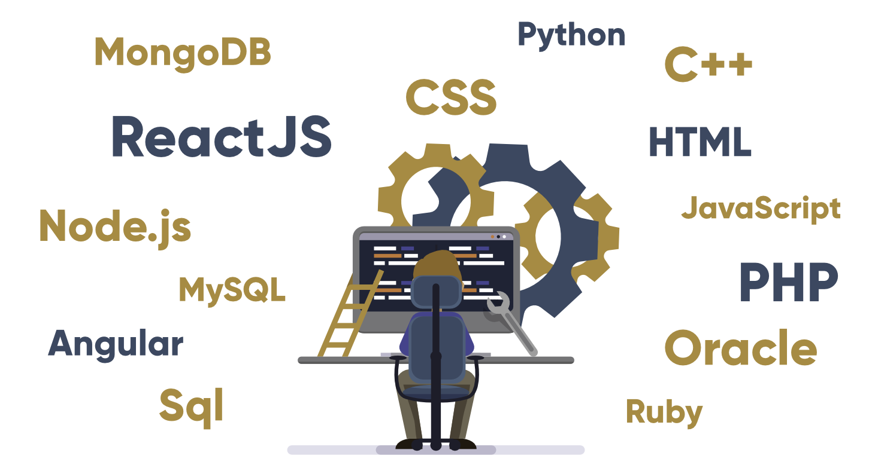
INTRODUCTION TO FULL STACK WEB DEVELOPMENT
Fullstack web development refers to the practice of building web applications that encompass both frontend and backend components. A full-stack developer is proficient in frontend technologies, such as HTML, CSS, and JavaScript, as well as backend technologies, such as server-side programming languages, databases, and server management. This holistic approach allows developers to create complete and cohesive web applications that meet the needs of both users and server-side processes.

Slide 3
FRONTEND DEVELOPMENT OVERVIEW
Front-end Development is the development or creation of a user interface using some markup languages and other tools. It is the development of the user side where only user interaction will be counted. It consists of the interface where buttons, texts, alignments, etc are involved and used by the user.
Languages for Front-end development:
Front-end Development Frameworks:
1.HTML
1.jQuery
4.Vue.js
2.CSS
2.React
5.Bootstrap
3.JavaScript
3.Angular
Responsive Web Development:
Front-End Security:
1.Breakpoints
1.DoS (denial of service) attacks
2.Preventing cross-site request forgery (CSRF)
2.Flexible Images
3.Cross-site scripting (XSS) attacks
3.Flexible Grids
4.Media Queries

Slide 4
BACKEND DEVELOPMENT OVERVIEW
Back-end development is the behind-the-scenes magic that makes websites and apps work. It’s the code that powers the database, server, and application—basically, everything that happens on the server side.
Back End Developer Skills:
Back End Developer Roles and Responsibilities:
Java
Python
PHP
SQL
Git
Back End Developer
Java Developer
Full-Stack Developer
DevOps Engineer
Software Engineer
iOS Developer

Slide 5
DATABASES IN FULL STACK DEVELOPMENT
Database management encompasses various aspects, including data modelling, querying, optimization, and maintenance, all of which play crucial roles in ensuring the efficiency and reliability of an application.
Importance of Database Management in Full Stack Development:
Key Concepts in Database Management:
1.Data Modeling
1.Data Storage
2.Querying
2.Data Integrity
3.Indexing
4.Transactions
3.Scalability
4.Performance
Best Practices for Database Management:
1.Normalize Data
3.Monitor Performance
2.Optimize Queries
4.Backup and Recovery

Slide 6
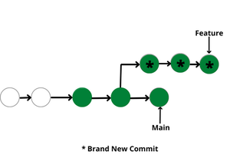
VERSION CONTROL SYSTEMS
Version control systems are a category of software tools that helps in recording changes made to files by keeping a track of modifications done in the code.
Use of Version Control System:
1.A repository
2.Copy of Work
3.Working in a group
Types of Version Control Systems:
Local Version Control Systems
Centralized Version Control Systems
Distributed Version Control Systems

Slide 7
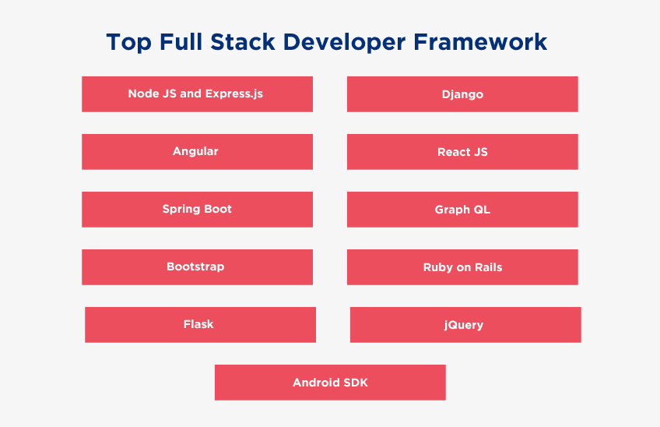
FULL STACK FRAMEWORKS
A full stack development framework is a collection of software that provides a complete end-to-end solution for web development.
Any developer will tell you that there is a never-ending debate over which development frameworks are the best. However, when it comes to full stack development, there are a few frameworks that stand out above the rest. Here, we will look at the best full stack developer frameworks for you.
Here is a list of best full stack development frameworks:
Node JS and Express.js (JavaScript Framework)
Django (Python Framework)
Angular (JavaScript Framework)
React JS (JavaScript Library)
Spring Boot (JavaScript Framework)
Graph QL (JavaScript Library)
Bootstrap (CSS Framework)
Ruby on Rails (Ruby Framework)
Flask (Python Framework)
jQuery (JavaScript Library)
Android SDK
Symfony

Slide 8
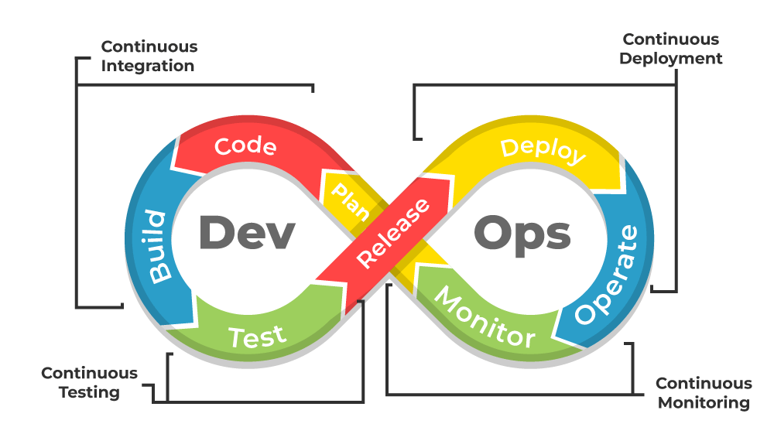
DEPLOYMENT & DEVOPS
It’s common to hear people referring to their deployment strategy as "DevOps", but that's not quite accurate. DevOps is a philosophy and culture, while deployment strategies are more narrowly focused on the actual steps used to deploy software.
DevOps is a collection of two words, ” Development ” and ” Operations ,” representing a cultural approach that emphasizes collaboration between development and operations teams to streamline the entire software delivery lifecycle.
Conclusion
DevOps is an excellent approach for delivering quality products more efficiently and helps an organization to stay competitive in today’s fast-paced digital world by focusing more on automating services, collaborations, and continuous improvement of the product’s features by adapting continuous integration and continuous delivery methodology.

Slide 9
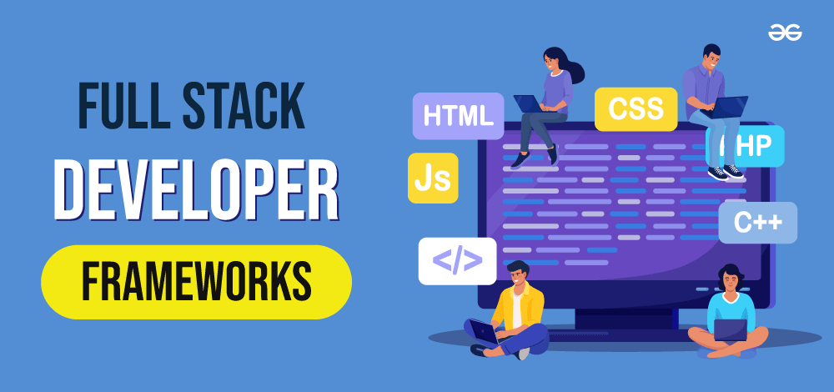
TOOLS FOR FULL STACK DEVELOPMENT
Full-Stack web development covers both front-end and back-end web development. So this article spans across front-end and back-end web development tools.
For each of the tools I outline, I will not fail to tell you what specific part of web development that tool belongs to.
Tools
VSCode
GitHub
Postman
Chrome DevTools
Bootstrap
React
Vue.js
Figma
NPM
Sass

Slide 10
CONCLUSION&FUTURE TRENDS
This online software industry is about innovation and scalability, on top of which highly skilled Full-Stack Developers are making it more innovative and taking the industry to a whole new level.
Low-Code/No-Code Development(LCNC)
Artificial Intelligence
Machine Learning
Block Chain
Cyber Security
Cloud Computing
Data Science
DevOps
Augmented Reality (AR) and Virtual Reality (VR)
Progressive Web Apps
Conclusion
Lastly, Full stack development is a constantly evolving and growing field that benefits both company and their customers, and as a technology enthusiast, you should learn these trending technologies to build amazing projects.

